Slide 1
Visual Organization
A People Centric View of Cross Platform Data

Slide 2
HRMS Data
Salary / Pay Information Performance Data
Job / Grade Information
Employee Classifications
Personal Information

Slide 3
Sales Data
Current Sales
Quota
Client Contacts
Sales Leads Contacts

Slide 4
Financial Data
Budget
Headcount
Total Cost to Company
Retirement
LTI Costs

Slide 5
Other Systems Data
Contractors
Shift Information
Vacation Accrued
Late Days
Certifications
Vendor Information

Slide 6
“Thin Layer” Across All Data Sources
Visual Organization
HRMS
Sales
Finance
Time / Attendance

Slide 7
HRMS | Sales | Finance | Other Systems
Current Salary | Current Quarter Sales | Budget / Expense | Certifications
Address | Current Quarter Quota | Headcount | Vacation Accrued
Birth Date | YTD Sales | Vacancies | Late Days
2012 Performance | Annual Quota | Retirement Elections | Health Coverage
2013 Performance | Client Contacts | P&L | Auto Reimbursement
Location | Prospects Information
Phone
Mobile Phone
eMail

Slide 8
HR Role
HRMS | Sales | Finance | Other Systems
Current Salary | Current Quarter Sales | Budget / Expense | Certifications
Address | Current Quarter Quota | Headcount | Vacation Accrued
Birth Date | YTD Sales | Vacancies | Late Days
2012 Performance | Annual Quota | Retirement Elections | Health Coverage
2013 Performance | Client Contacts | P&L | Auto Reimbursement
Location | Prospects Information
Phone
Mobile Phone
eMail

Slide 9
Finance Role
HRMS | Sales | Finance | Other Systems
Current Salary | Current Quarter Sales | Budget / Expense | Certifications
Address | Current Quarter Quota | Headcount | Vacation Accrued
Birth Date | YTD Sales | Vacancies | Late Days
2012 Performance | Annual Quota | Retirement Elections | Health Coverage
2013 Performance | Client Contacts | P&L | Auto Reimbursement
Location | Prospects Information
Phone
Mobile Phone
eMail

Slide 10
Manager Role
HRMS | Sales | Finance | Other Systems
Current Salary | Current Quarter Sales | Budget / Expense | Certifications
Address | Current Quarter Quota | Headcount | Vacation Accrued
Birth Date | YTD Sales | Vacancies | Late Days
2012 Performance | Annual Quota | Retirement Elections | Health Coverage
2013 Performance | Client Contacts | P&L | Auto Reimbursement
Location | Prospects Information
Phone
Mobile Phone
eMail

Slide 11
HR Role

Slide 12
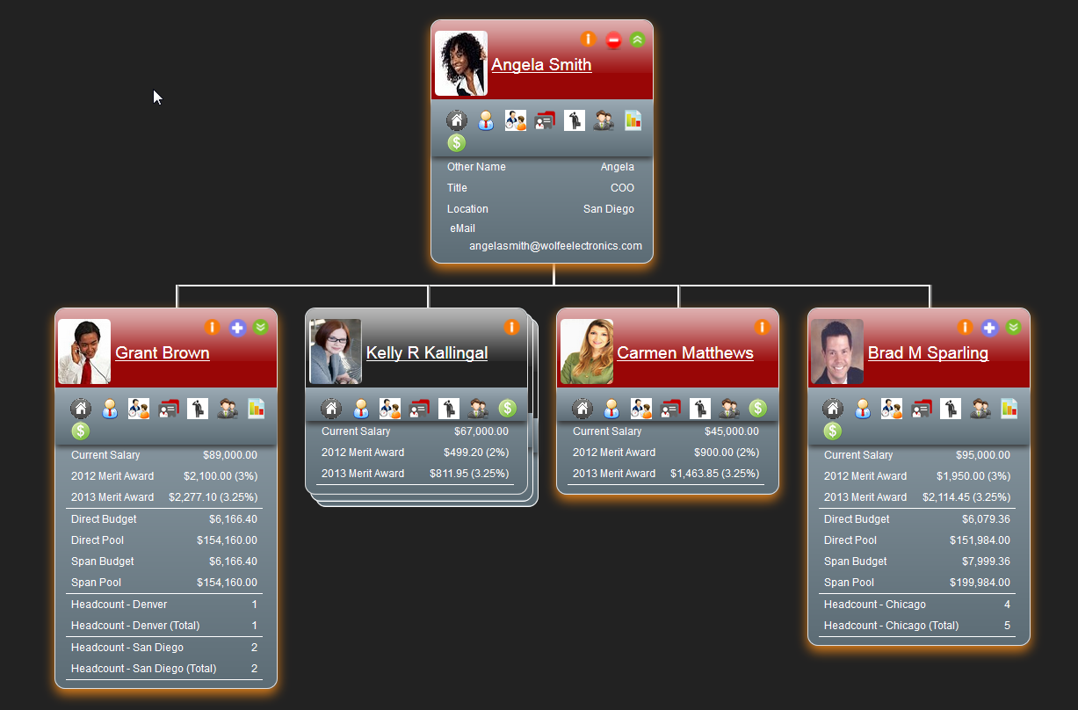
Finance Role

Slide 13
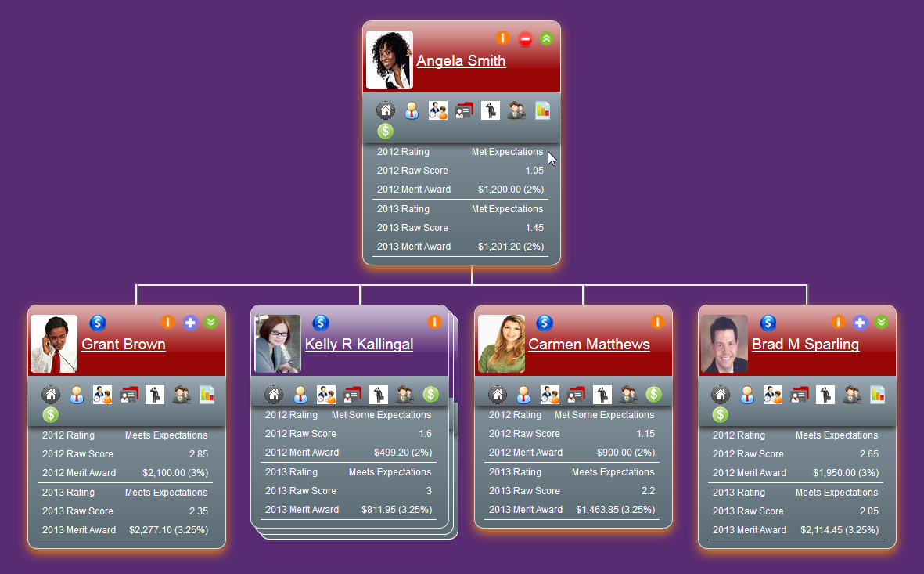
Manager Role

Slide 14
You will….
Gain insight into the entire organization; including contractors, vendors, partners, prospects and customers
Leverage cross platform data with enhanced multi-conditional searching
Evolve from tabular reports to a people centric representation

Slide 15
Contact us at Sentient, Inc. at:
Rob Sweetser
Rob.sweetser@sentient-inc.com Direct : (859) 360-0111 Mobile: (859) 991-9701

